Slide 1
F8S1 – Wind Siting
Within the MISO footprint, a set of renewable energy zones focusing on wind capacity were developed through extensive work with stakeholders
Final product was given approval through Midwest Governors Association (MGA) and the Upper Midwest Transmission Development Initiative (UMTDI) participant states

Slide 2
F8S1 – Wind Siting
The development of the zones focused on the identification of high capacity factor wind areas in each of the states
Intent of the zone development was to balance high capacity factor regional resources with local investment opportunity
Regional planning is being implemented based on these zones and therefore these zones are highly likely to be where renewable energy will locate, and should be the primary location for the distribution of wind within the MISO footprint

Slide 3
F8S1 – Wind Siting
Premise of zone development was to have equivalent maximum capability in each zone.
Resulted in a 55/45 split between siting of wind in the MISO West region to the rest of the footprint
The distribution of wind in the EIPC has roughly 60% of the forecast wind in the West subregion compared to the rest of the footprint.
Roughly comparable to the initial intent of the MISO RGOS zone development
Because of the assumption of equivalent capacity in each zone in the MISO process, it is proposed that the EIPC distribute the non MISO West wind (40% of total MISO wind identified) as equivalent capability in each of the identified MISO RGOS zones

Slide 4
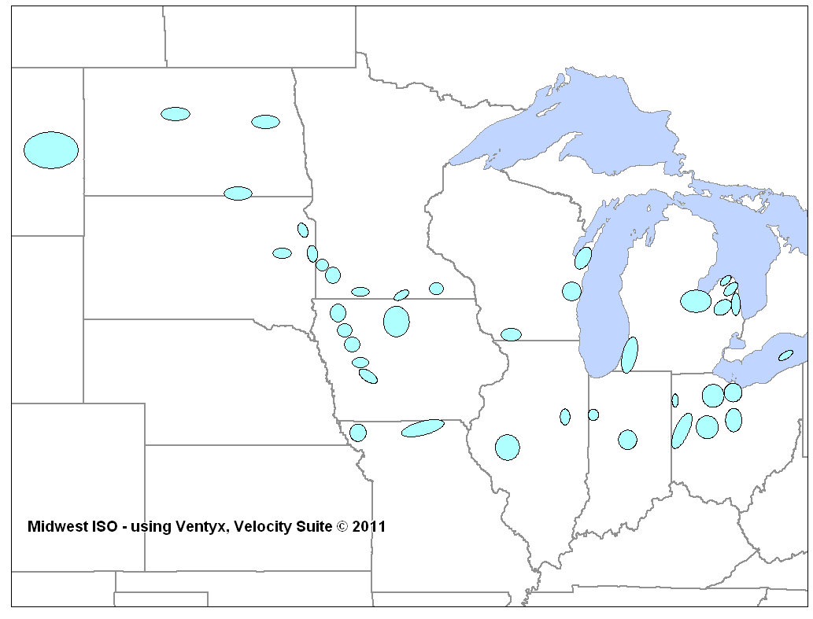
When this approach is used to redistribute the non-West wind additions from the F8S1 case, the results are as shown
MISO W
MISO WUMS
60,831
MISO MI
7,894
15,787
MISO MO/IL
5,262
10,525
MISO IN

Slide 5
F8S1 – Wind Siting for Non MISO West Wind
 | Original Distribution | New Distribution | % of Indiana Wind Distributed to NEEM Region | # of MISO RGOS Zones in Region
MISO IN | 29,432 | 5,262 | 17.88% | 2
MISO MI | 2,600 | 15,787 | 44.80% | 6
MISO MO/IL | 6,017 | 10,525 | 15.32% | 4
MISO WUMS | 1,419 | 7,894 | 22.00% | 3
Total | 39,468 | 39,468 | 100% | 15
39,468 MW spread over 15 zones results in a distribution of 2,631 MW per zone, consistent with the methodology applied to the MISO Regional Planning process.

Slide 6
F8S1 – Combined Cycle Siting
Significant retirements identified within the MISO footprint. The spread of the retirements appears to be fairly balanced between the NEEM regions for the MISO system.
It is recommended that the combined cycle build be distributed at the same ratio of how the retirements occurred
Will support locational reserve requirements
Will support local transmission thermal and voltage support
Reasonable assumption that repower of retirement sites may be cheaper than the greenfield sites that are being modeled

Slide 7
F1S3 Combustion Turbine Siting
Combustion turbines are generally being added to meet resource adequacy needs with minimum energy dispatch
To meet more of the locational nature of resource adequacy needs, it is recommended that the peaking capacity be spread through the various NEEMS regions based on a load or energy ratio distribution for the MISO system
This will provide a distribution of the capacity with minimal effect on the transfer of economic energy across the system

Slide 8
F6S10 Combustion Turbine Siting
Utilize same methodology in F1S3 for first 4,597 MW
For the remaining 7,092 MW, distribute the CT build to co-locate with wind capacity
Distribute by the proportion of cumulative wind builds in the scenario
Allows for operational coordination between fleets to utilize the same transmission

