Slide 1
F1S17: Final BAU Capacity and Generation Graphs
S. W. Hadley
Nov. 16, 2011

Slide 2
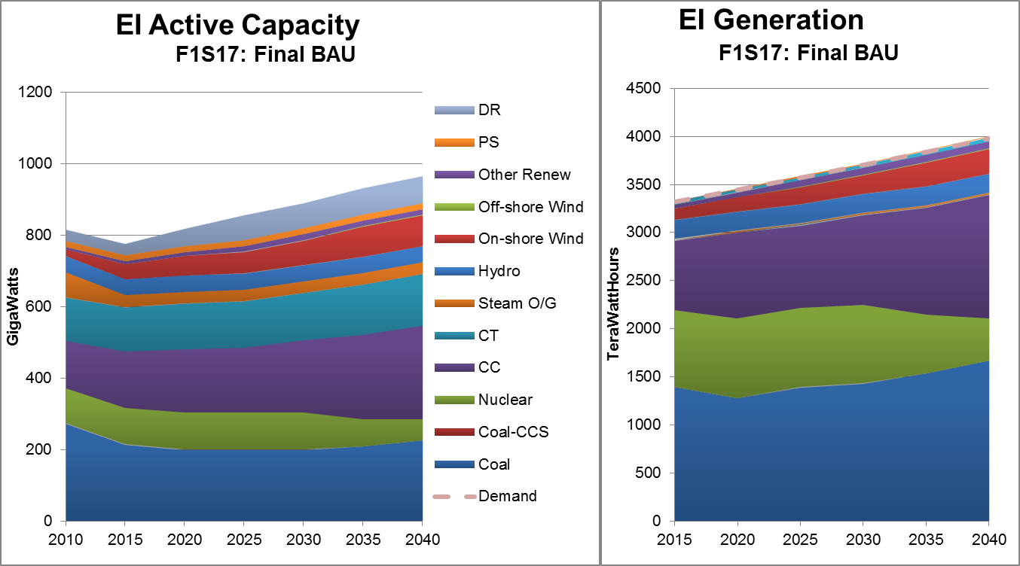
Eastern Interconnect continues present mix of technologies

Slide 3
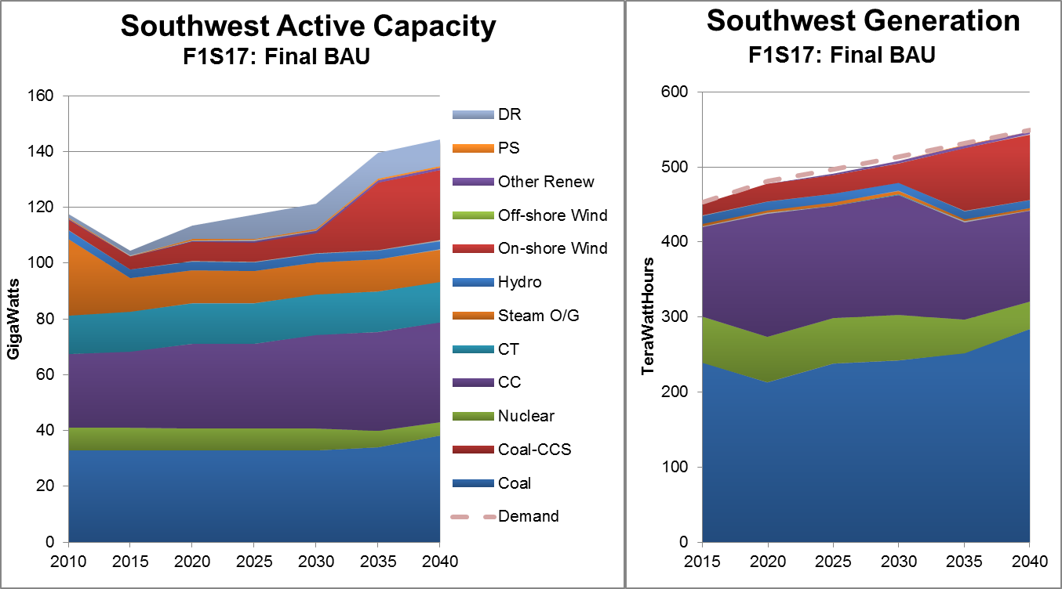
Southwest dominated by coal and CC through 2030

Slide 4
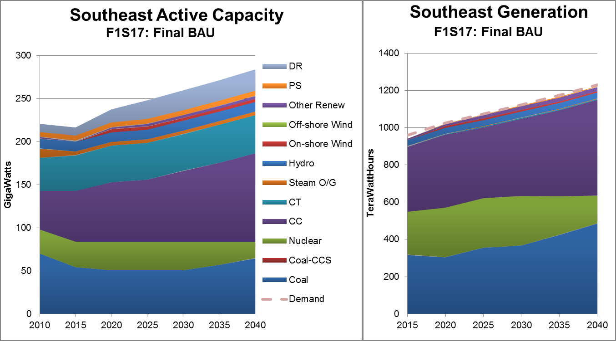
Southeast uses CC, coal, and nuclear

Slide 5
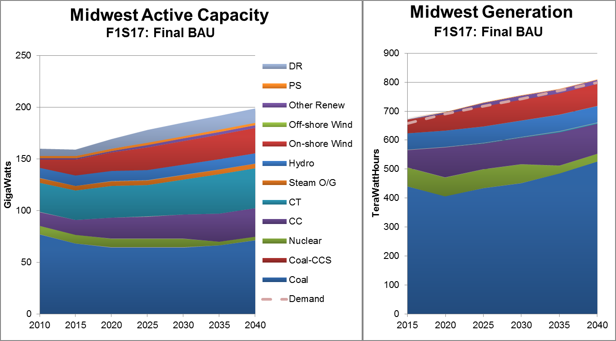
Midwest largely coal with some wind and hydro

Slide 6
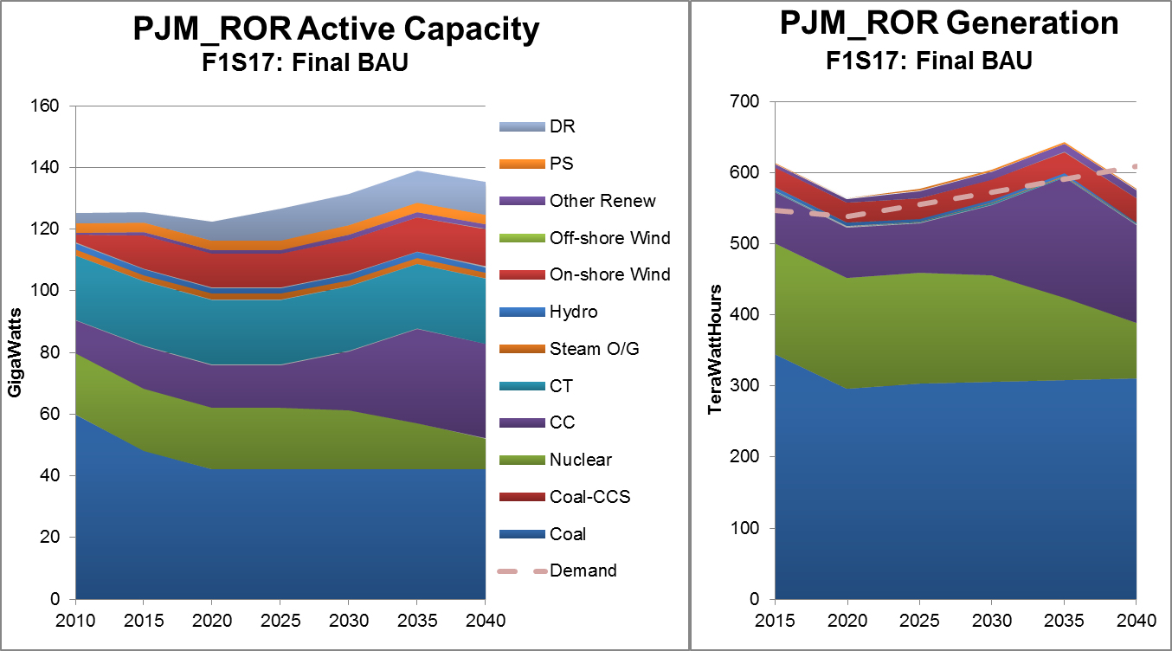
PJM_ROR uses mainly coal, nuclear, and CC

Slide 7
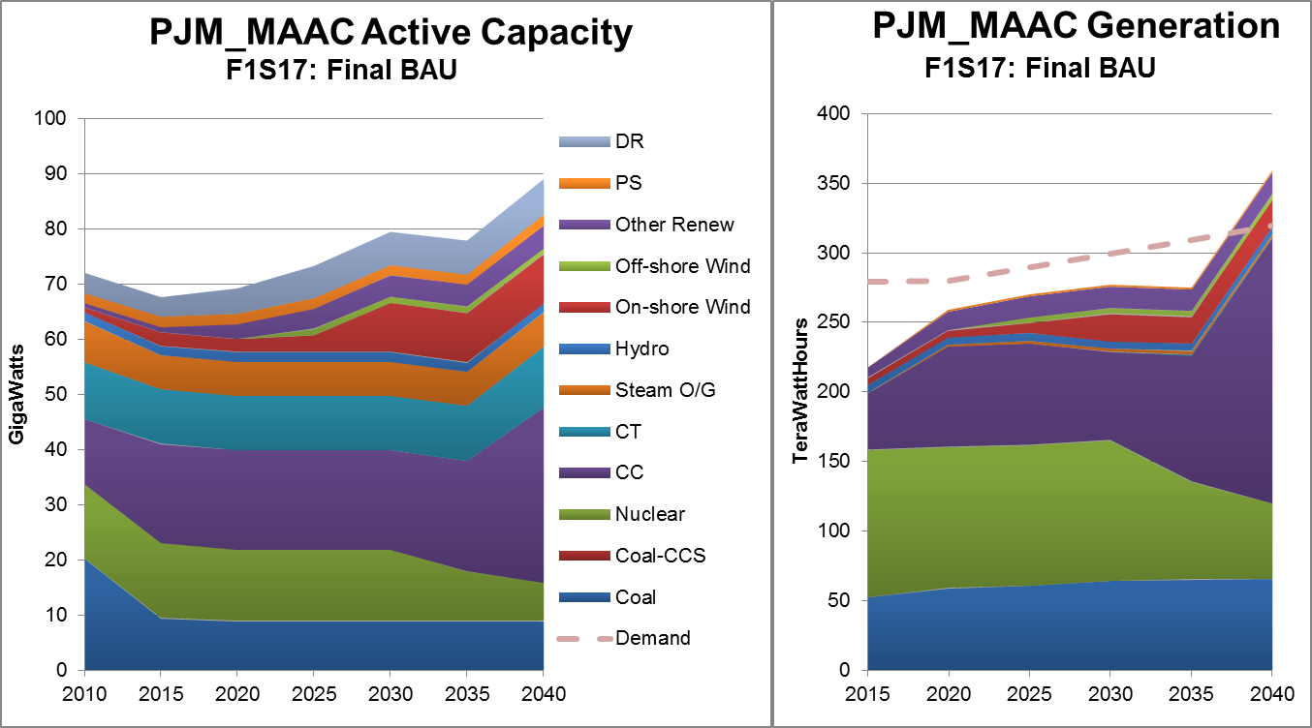
PJM_MAAC shows diversity in capacity but largely coal, nuclear, CC generation

Slide 8
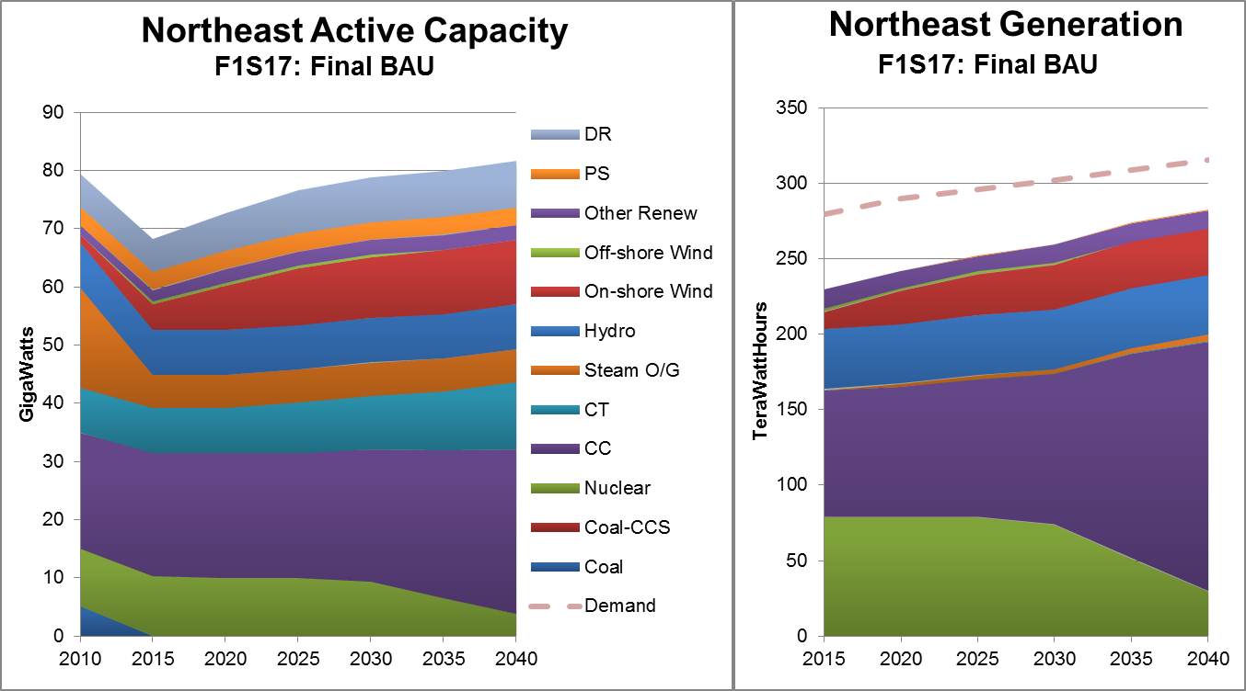
Northeast uses imports and renewables

Slide 9
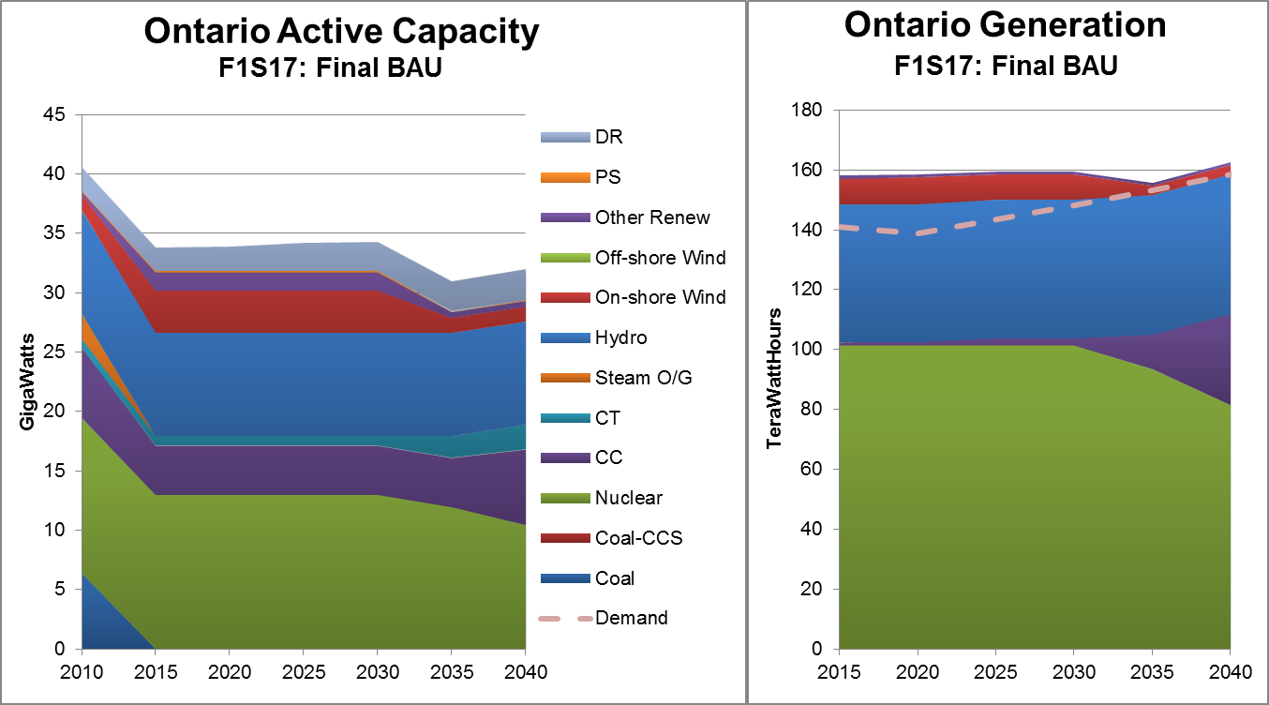
Ontario dominated by nuclear and hydro

