Slide 1
F8S7: Final Future 8 Capacity and Generation Charts
S. W. Hadley
Nov. 15, 2011

Slide 2
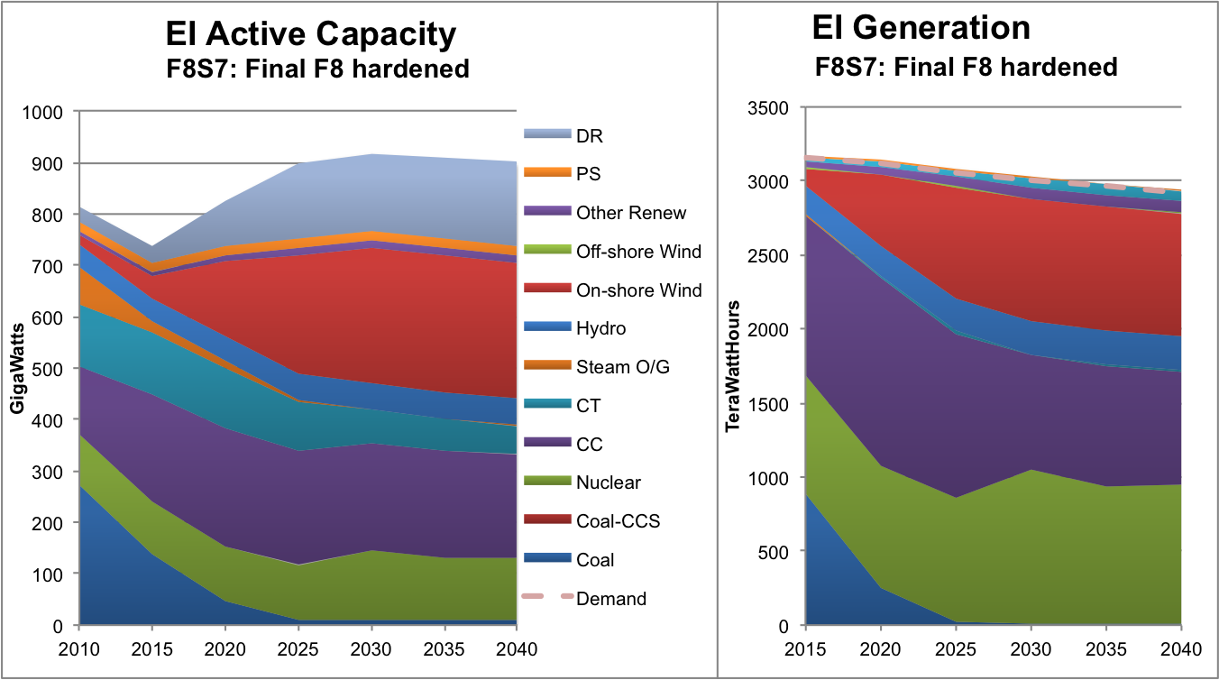
Entire Eastern Interconnect shows mix of Technologies

Slide 3
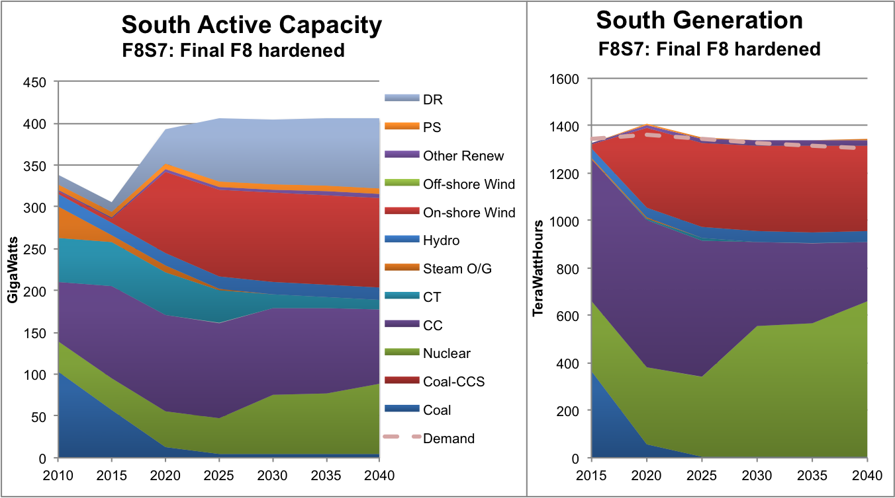
South (Southwest + Southeast) shows largely wind, CC and nuclear

Slide 4
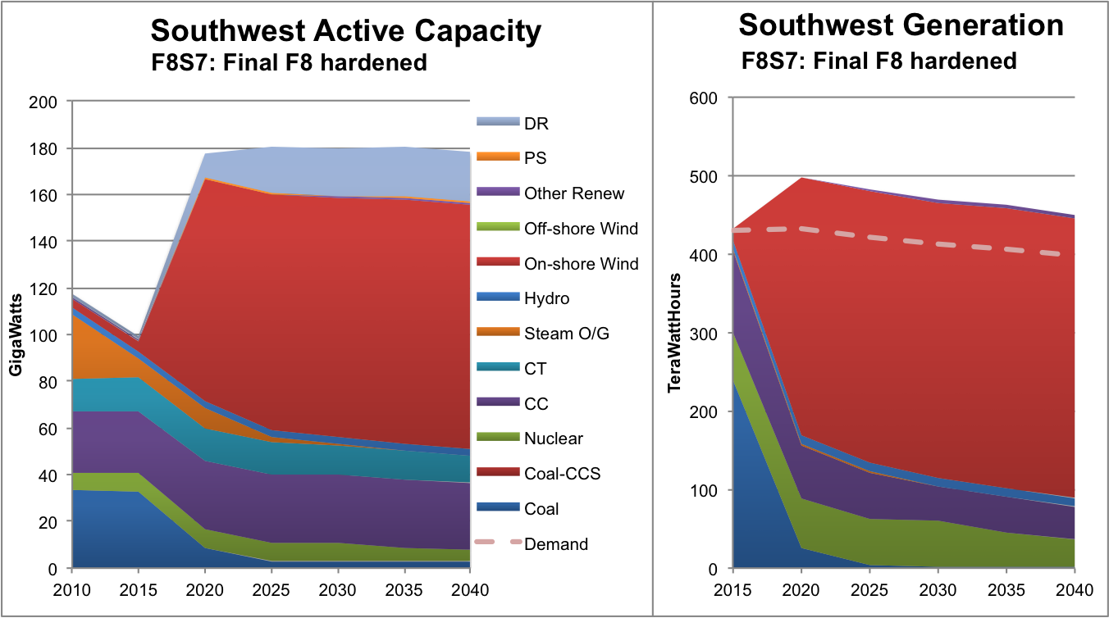
Southwest (SPP, NE, ENT) has very high share of wind generation

Slide 5
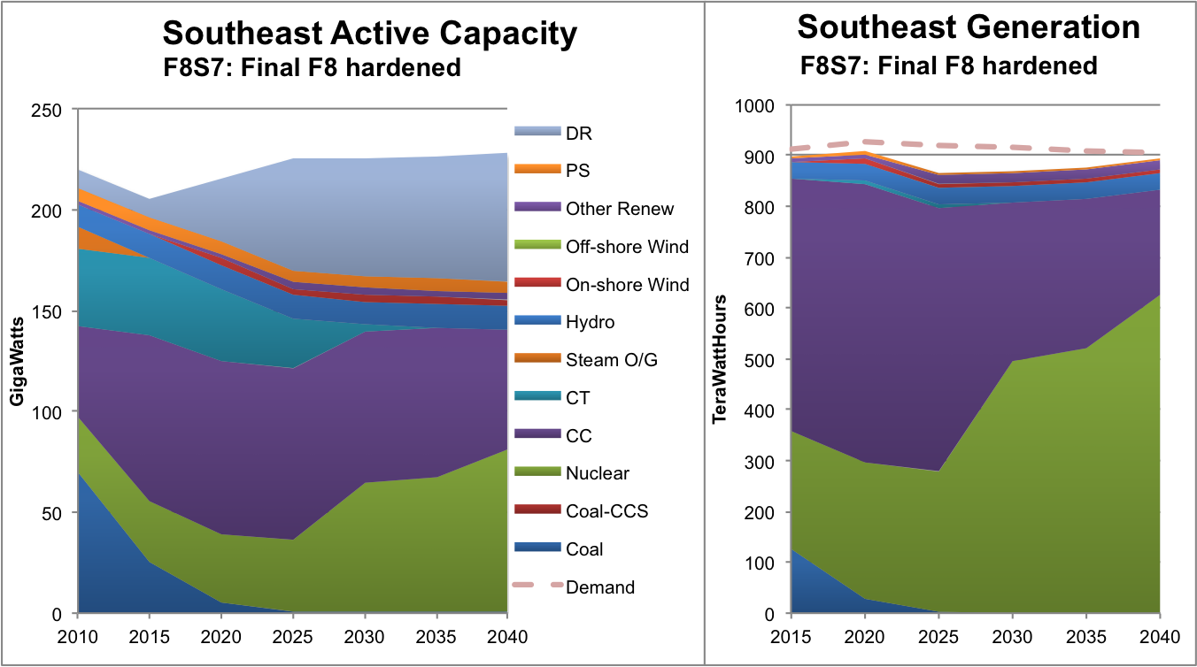
Southeast is largely nuclear and CC

Slide 6
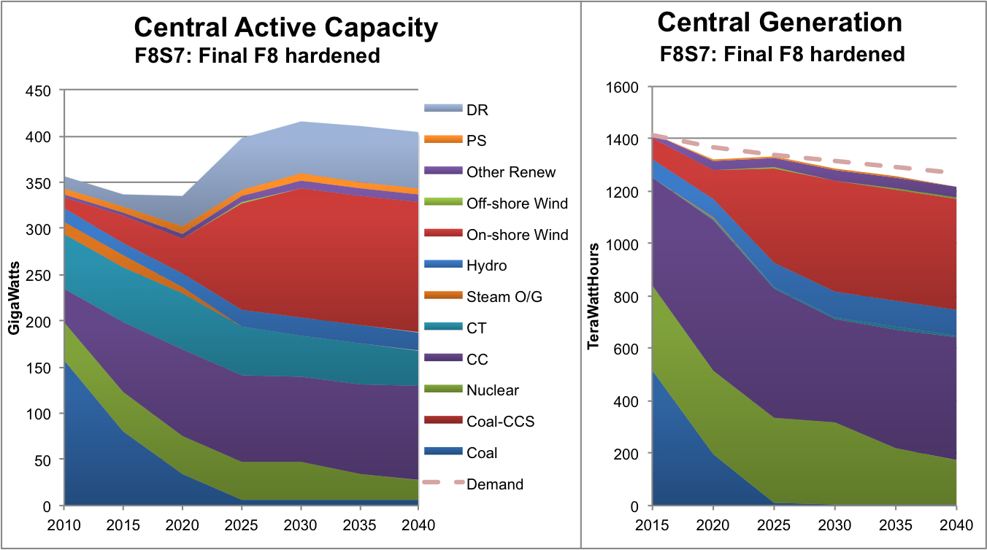
Central (MAPP, MISO, PJM) largely wind, CC, nuclear, and hydro

Slide 7
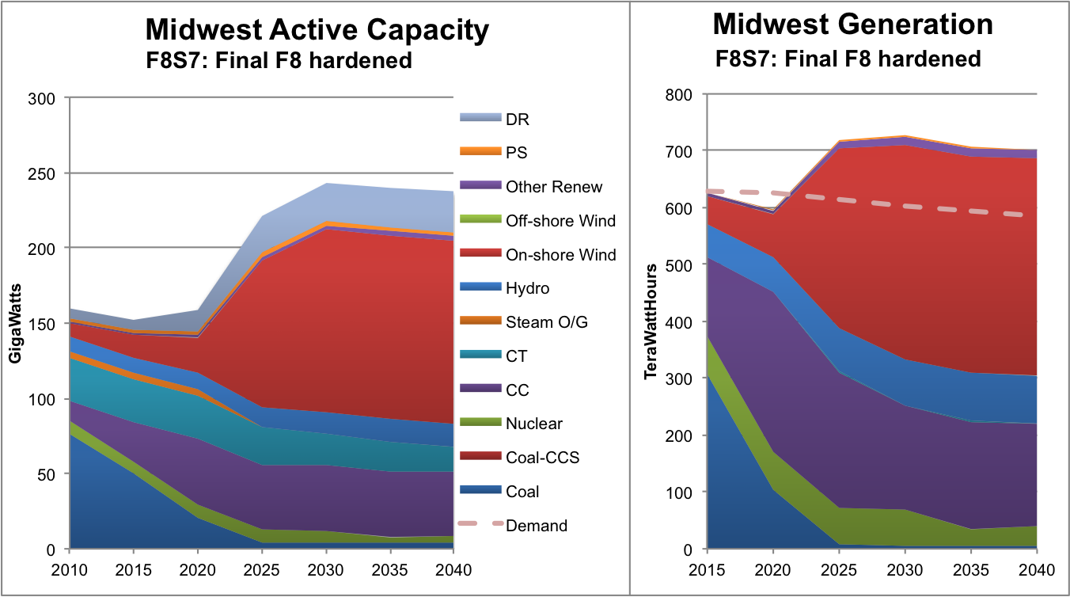
Midwest (MAPP, MISO) have high share of wind

Slide 8
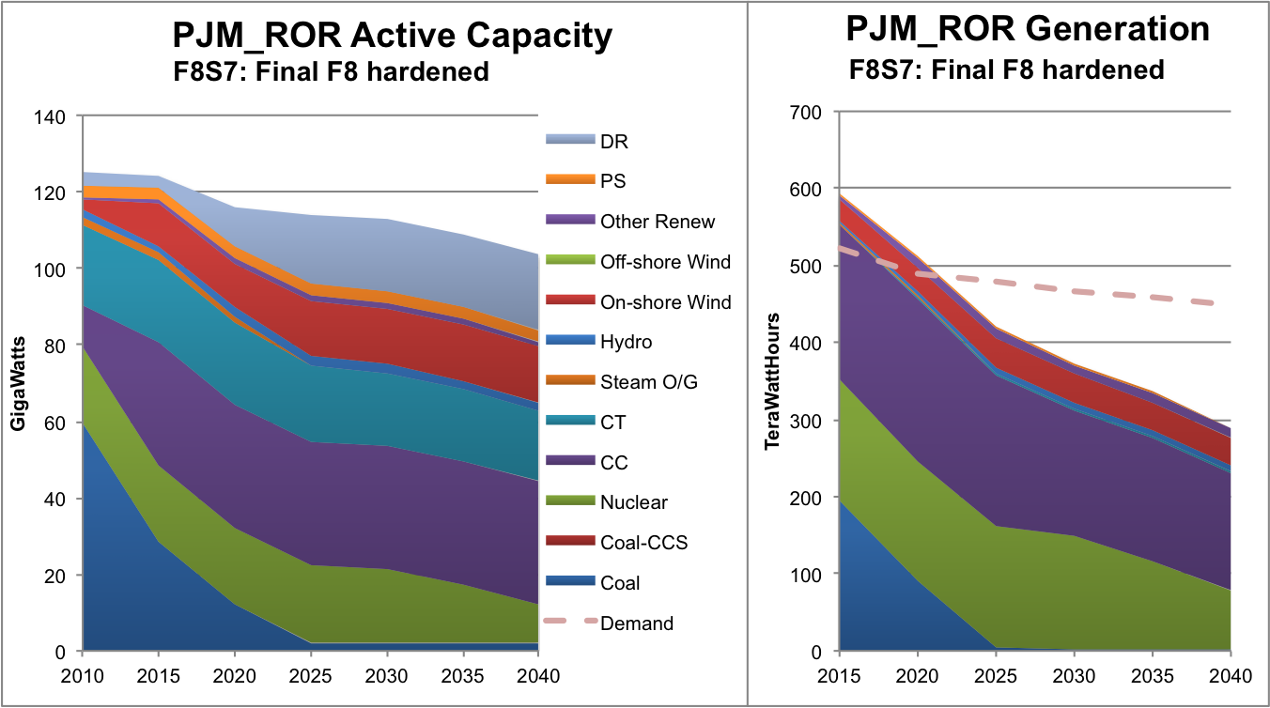
PJM_ROR shows steady decline in generation, use imports instead

Slide 9
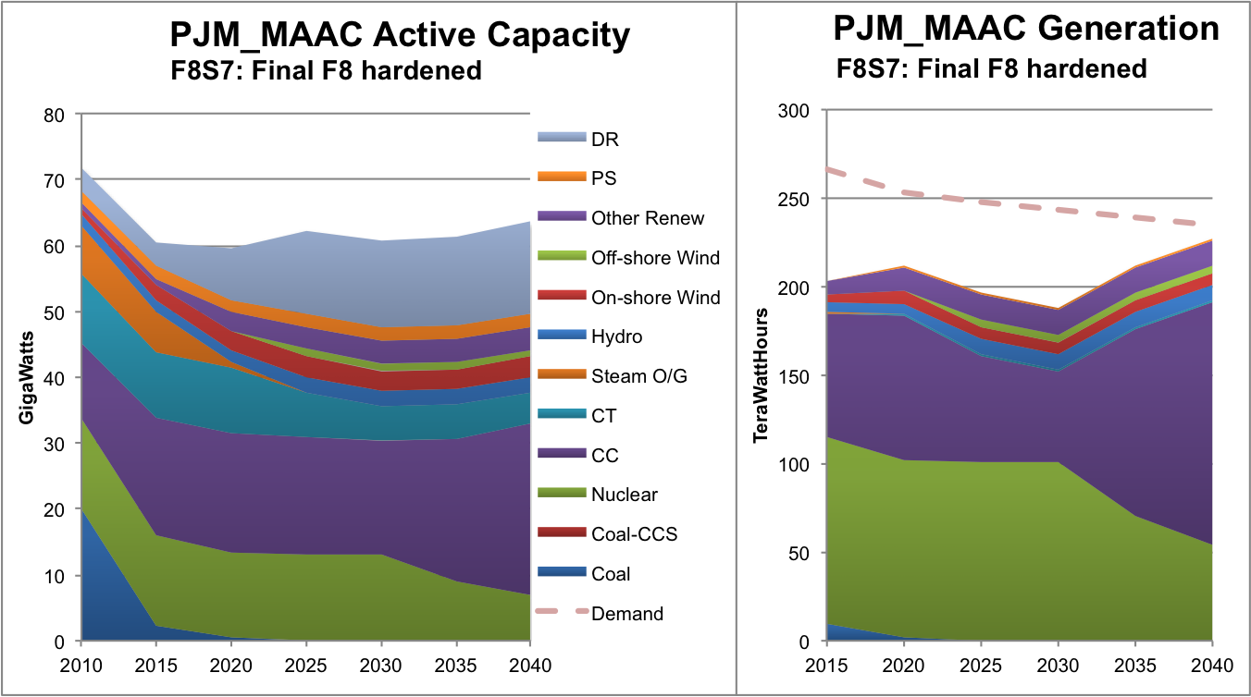
PJM_MAAC imports power for most of period, nuclear other supplier

Slide 10
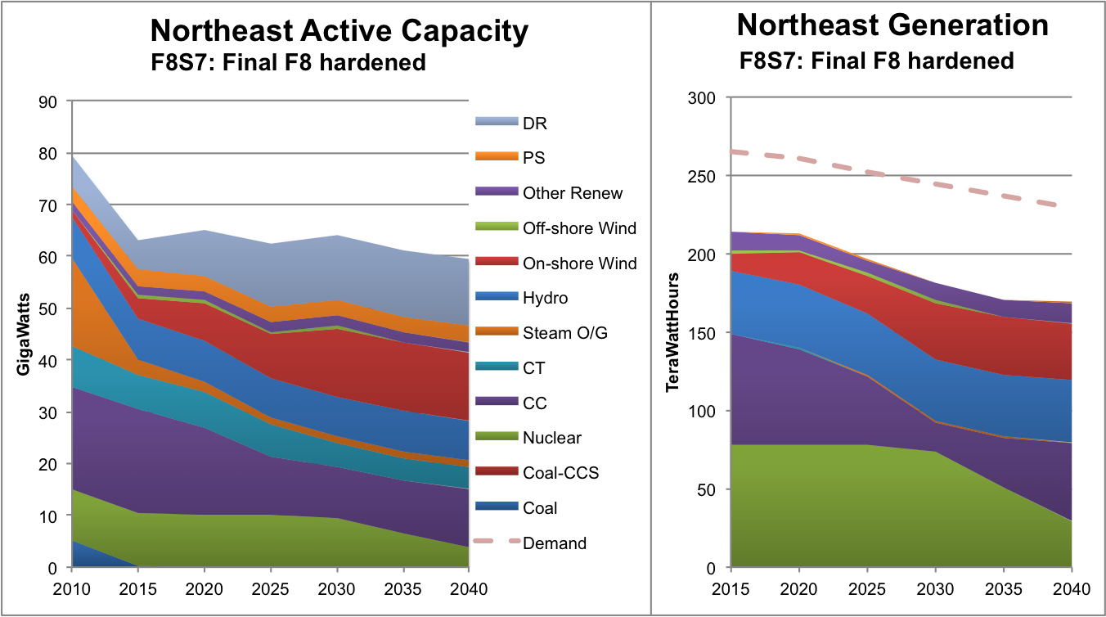
Northeast imports significantly from Canada

Slide 11
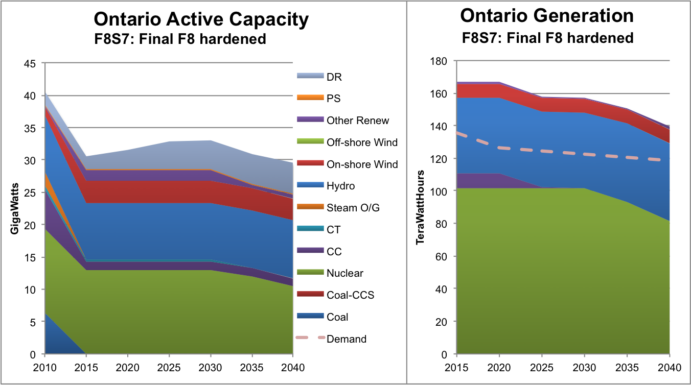
Ontario gets most power from nuclear and hydro

