Slide 1
F6S10: Final Future 6 Capacity and Generation Graphs
S. W. Hadley
Nov. 16, 2011

Slide 2
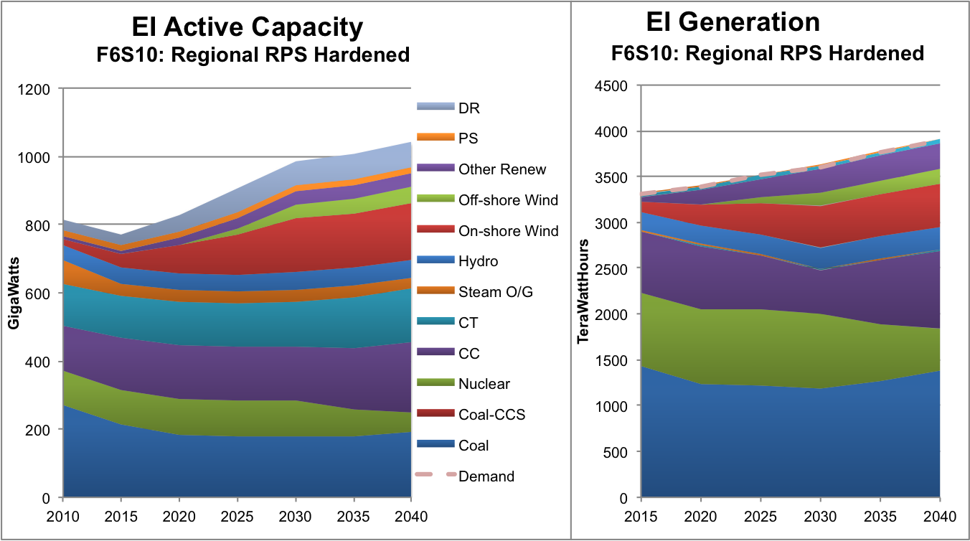
Eastern Interconnect shows diversity of technologies

Slide 3
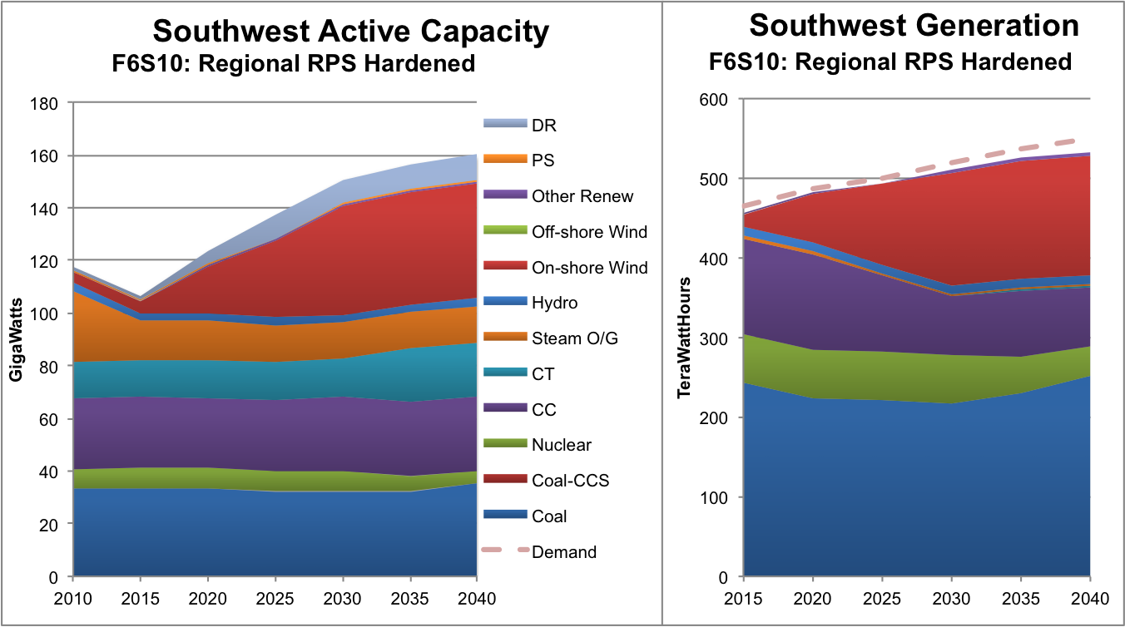
Southwest mainly coal and wind

Slide 4
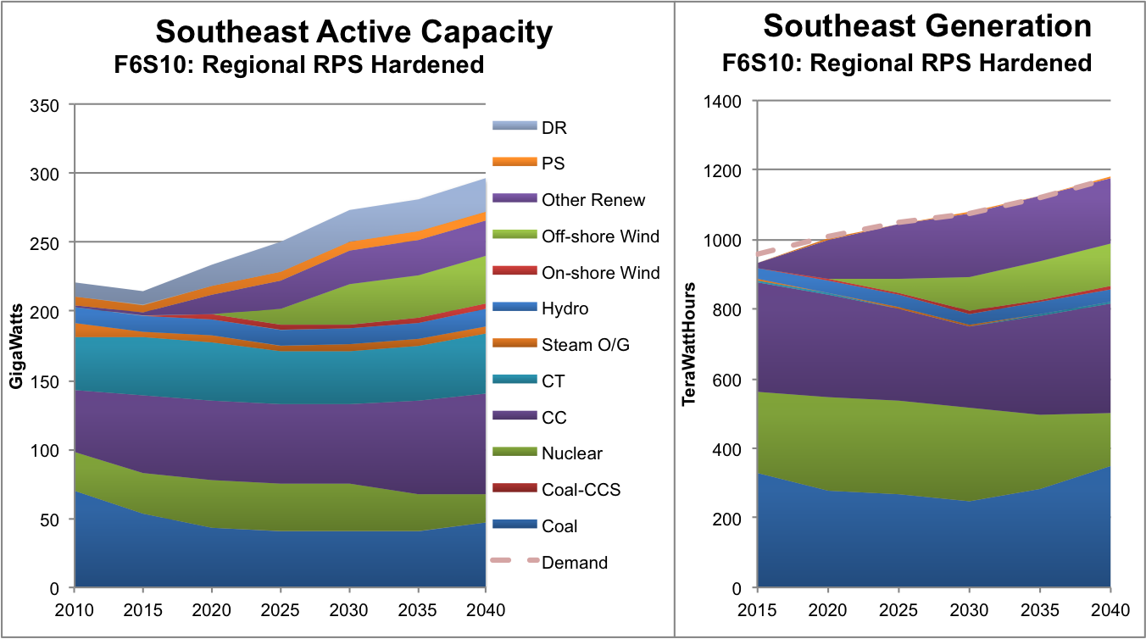
Southeast includes off-shore wind and other renewables

Slide 5
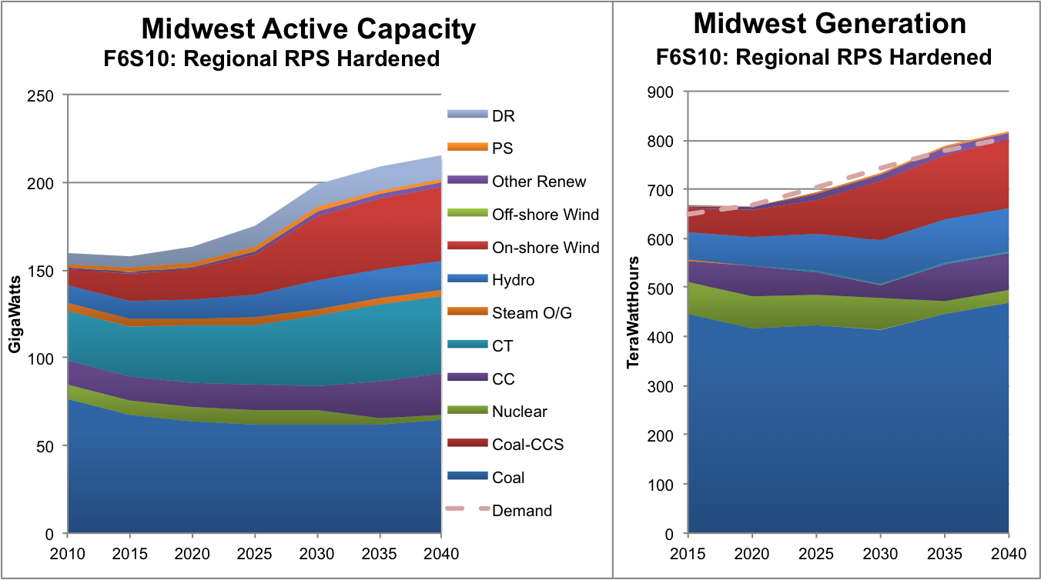
Midwest dominated by coal with some wind and hydro

Slide 6
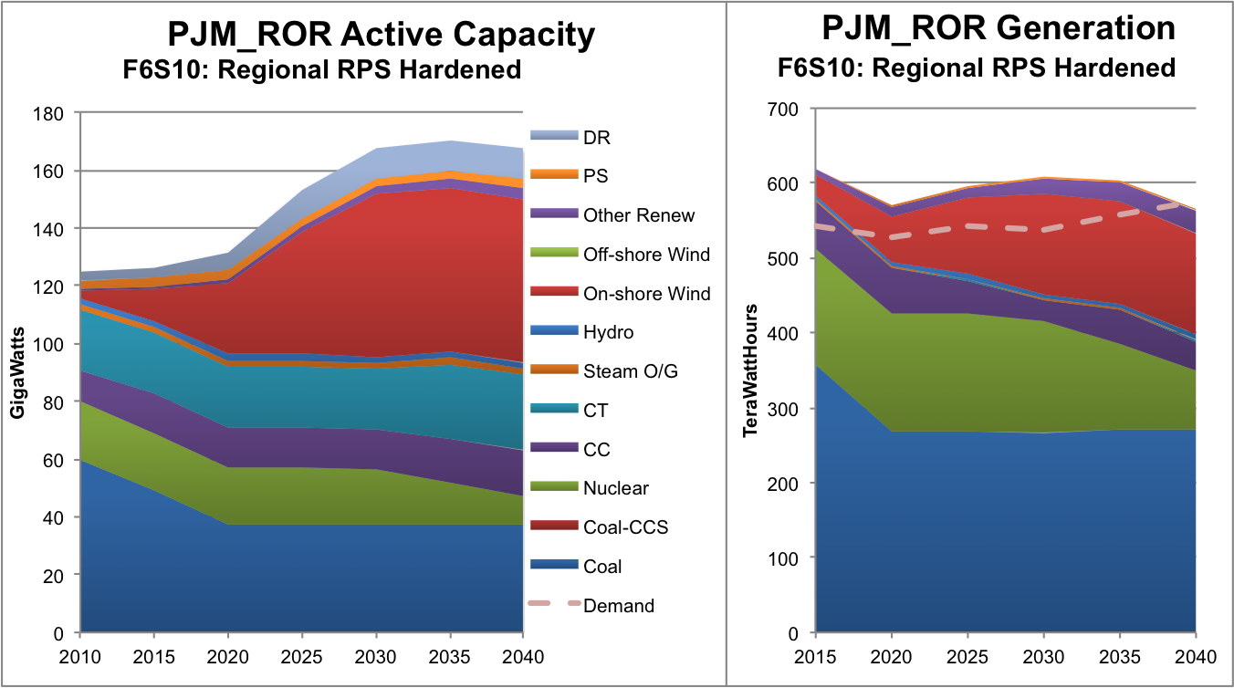
PJM_ROR power from coal, nuclear, and wind

Slide 7
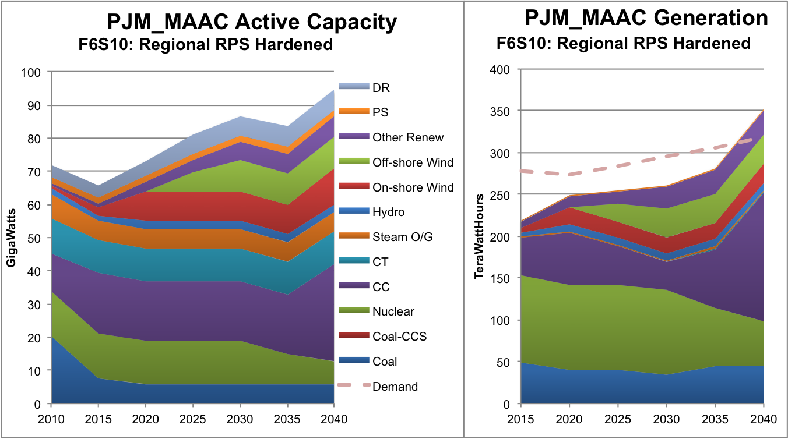
PJM_MAAC shows large nuclear and various renewables

Slide 8
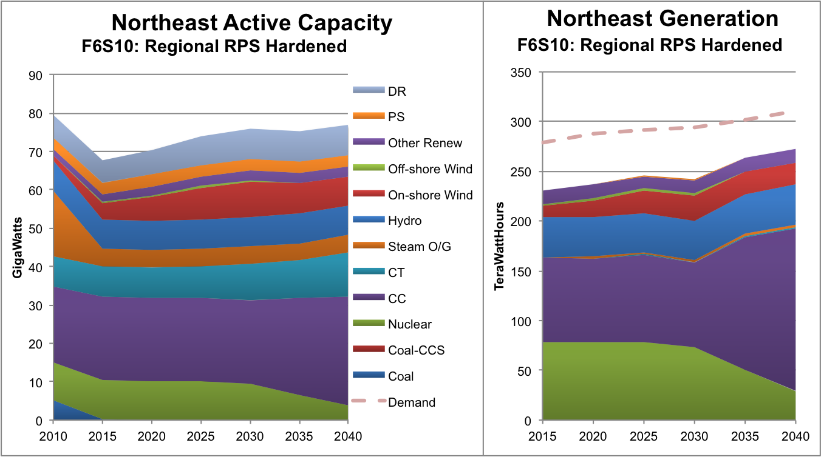
Northeast uses HQ/Maritimes imports plus multiple renewables

Slide 9
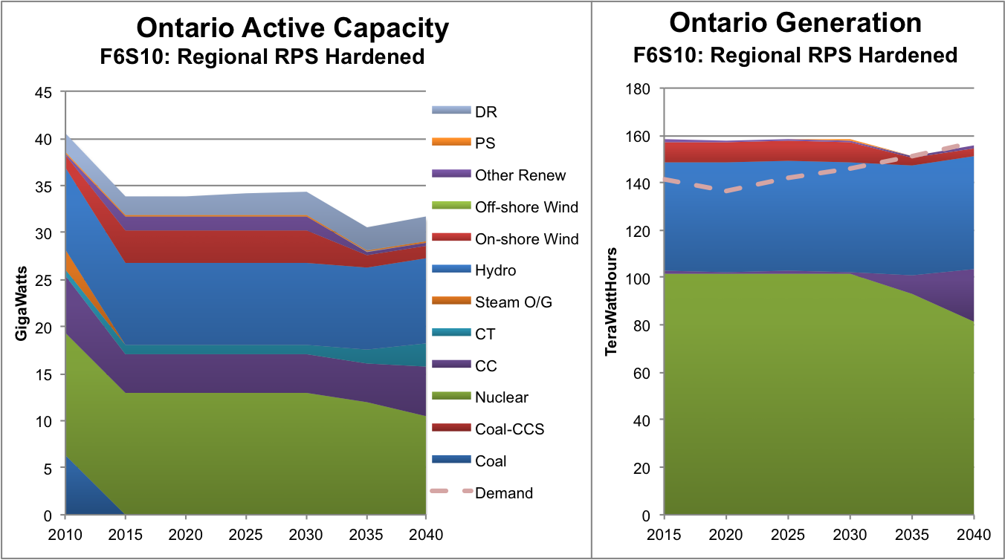
Ontario dominated by nuclear and hydro

